Slide 1
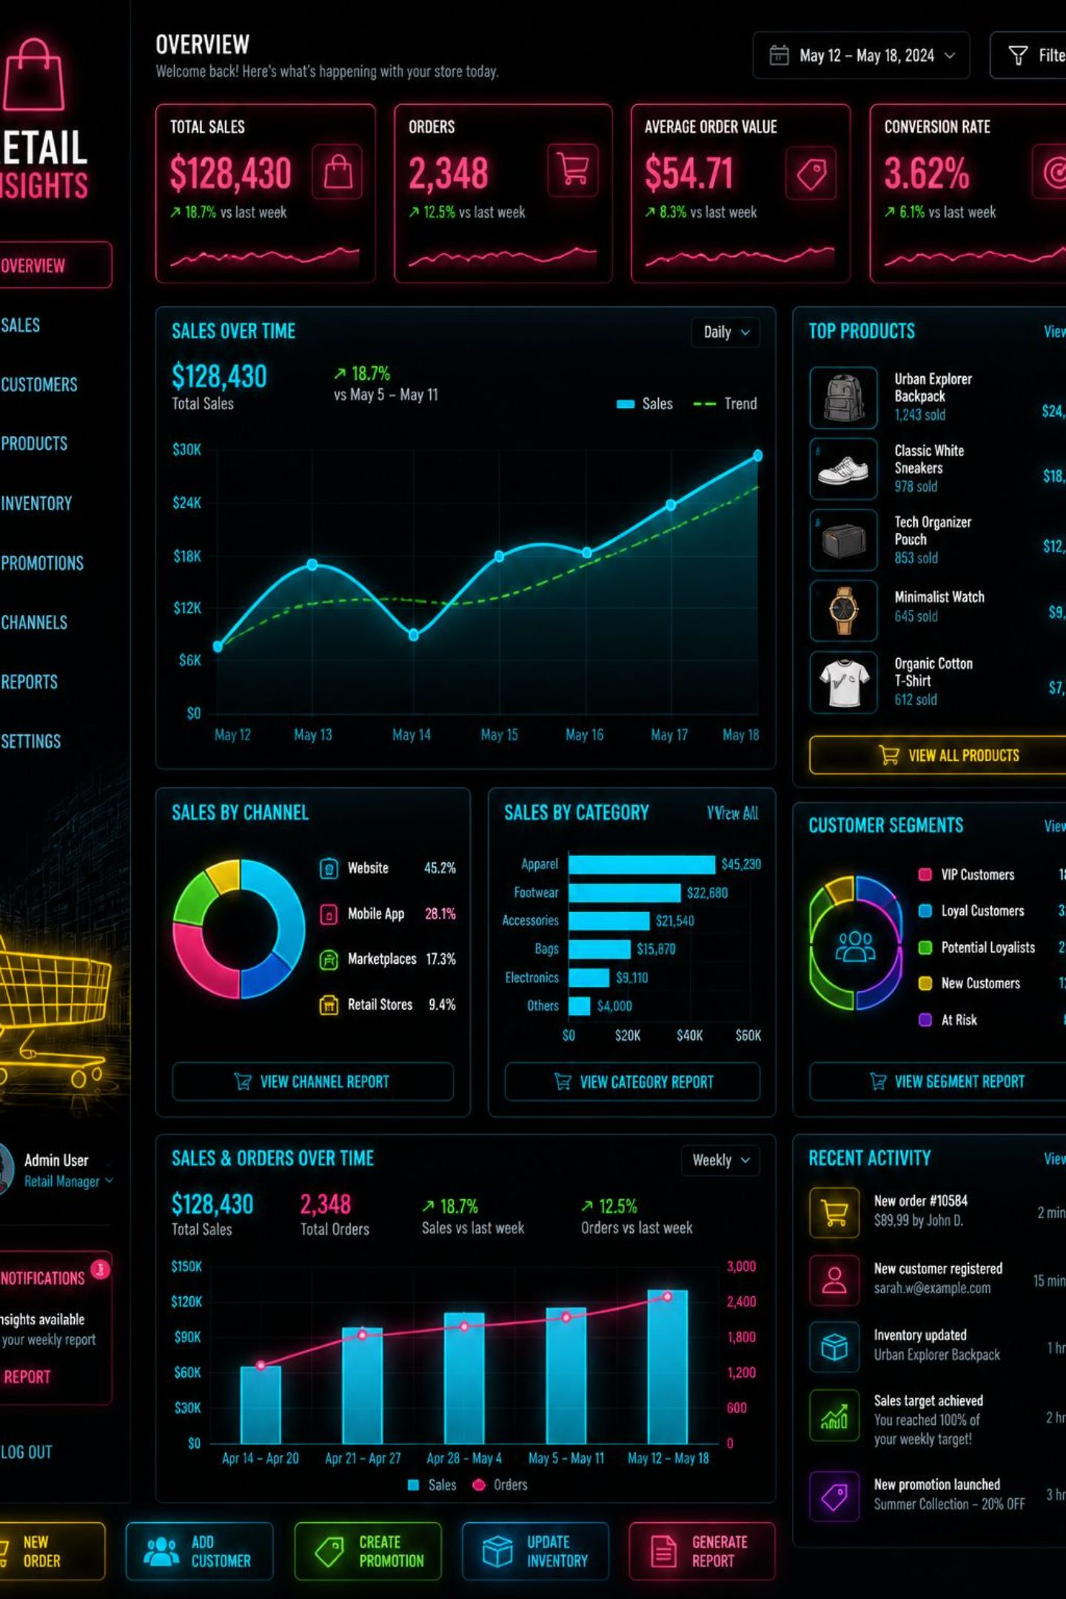
Customer Shopping Behavior Analysis
Uncovering insights from 3,900 transactions across product categories — spending patterns, customer segments, and subscription behavior — to guide strategic business decisions.

Slide 2
Dataset at a Glance
3,900
18
Total Purchases
Data Columns
Transactional records analyzed
Features spanning demographics, purchases & behavior
37
50
Missing Values
Locations
In Review Rating column only
Unique geographic regions
Key features include customer demographics (Age, Gender, Location, Subscription Status), purchase details (Item, Category, Amount, Season), and shopping behavior (Discount, Promo Code, Frequency, Review Rating, Shipping Type).

Slide 3
Data Preparation in Python
01
02
Load & Explore
Clean Missing Data
Imported dataset via pandas; used df.info() and .describe() for structure and summary stats.
Imputed missing Review Rating values using the median rating per product category.
03
04
Feature Engineering
Database Integration
Created age_group by binning ages; derived purchase_frequency_days; dropped redundant promo_code_used.
Connected to PostgreSQL and loaded the cleaned DataFrame for SQL analysis.

Slide 4
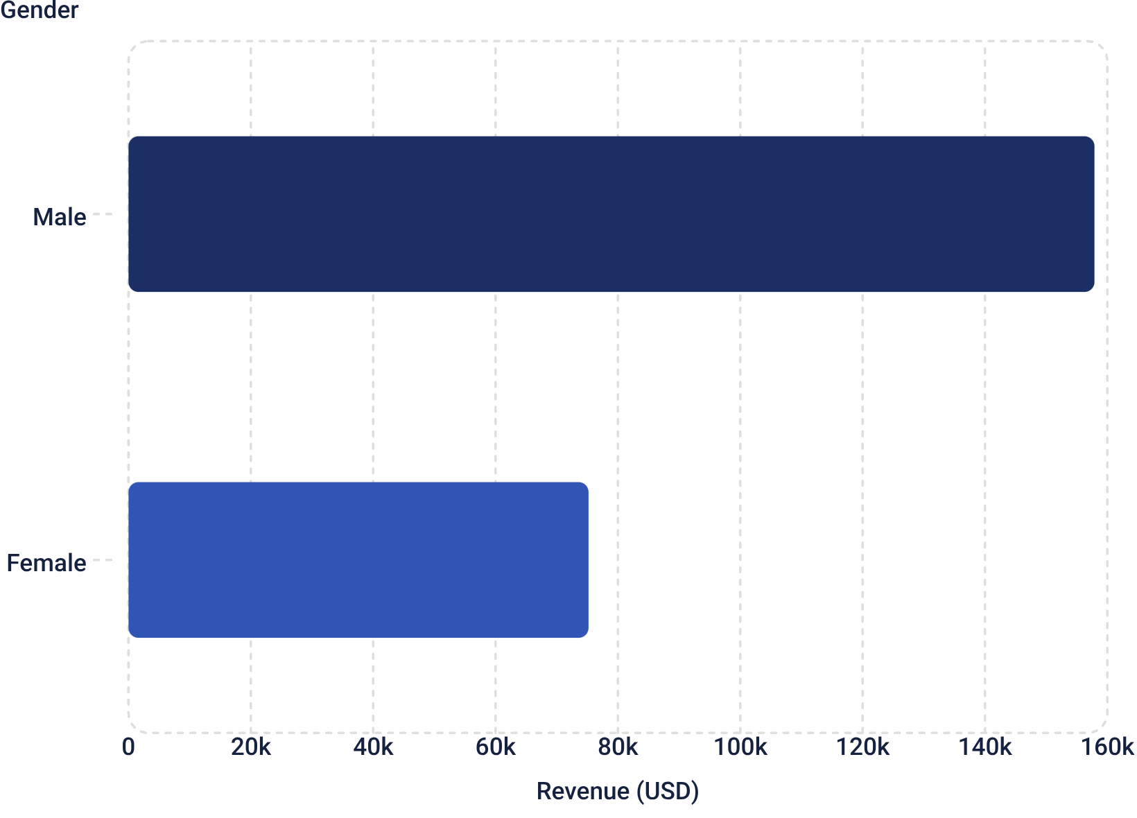
Revenue & Spending Insights
Key Findings
Male customers generated over 2× the revenue of female customers
Average purchase amount: $59.76
839 customers used discounts and spent above average
Express shipping averaged $60.48 vs. Standard at $58.46

Slide 5
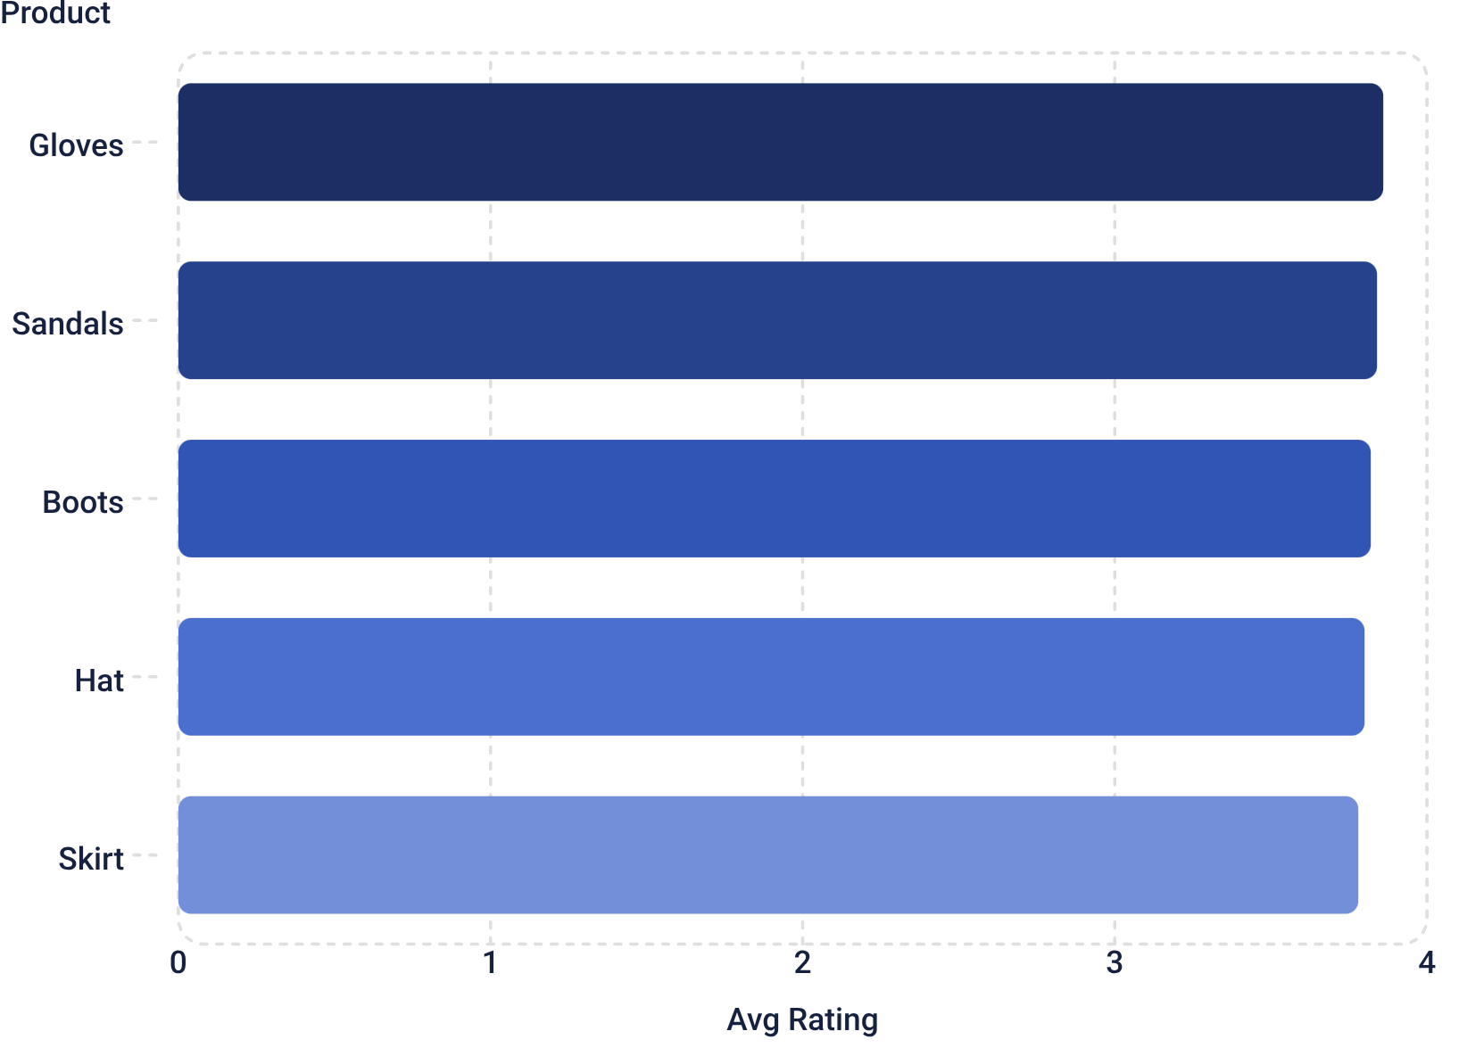

Product Ratings & Discount Behavior
Top 5 Products by Rating
Most Discount-Dependent Products
Hat — 50%
Sneakers — 49.66%
Highest discount rate
Nearly half discounted
Coat — 49.07%
Sweater — 48.17%
Seasonal sensitivity
Outerwear trend
Pants — 47.37%
Clothing category

Slide 6
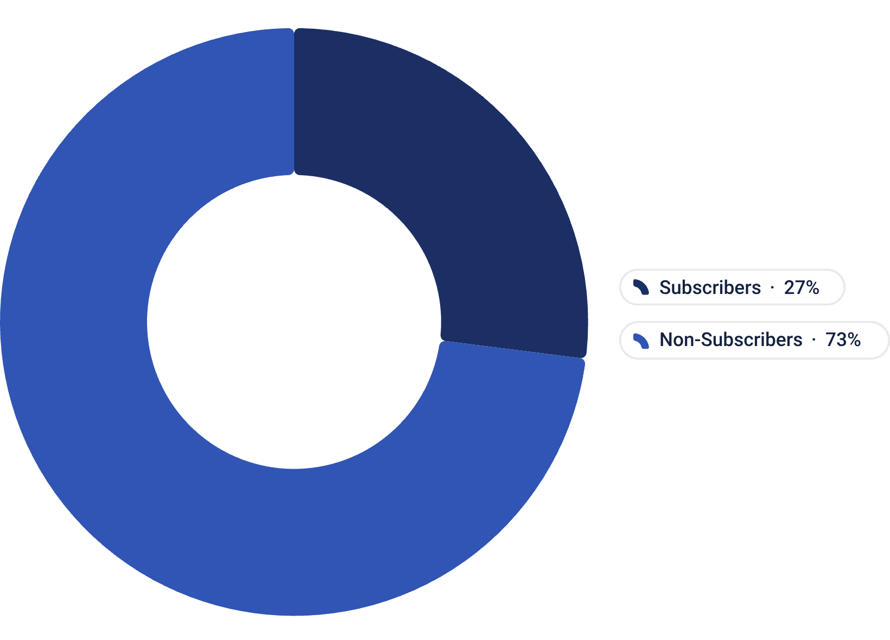

Subscription & Customer Segmentation
Subscription Insights
Only 27% of customers are subscribers
Non-subscribers spend slightly more on average ($59.87 vs. $59.49)
Non-subscribers generated $170,436 in total revenue vs. $62,645 for subscribers
Of repeat buyers (>5 purchases): 2,518 are non-subscribers vs. 958 subscribers
Large opportunity to convert high-frequency non-subscribers.

Slide 7

Customer Segments & Age Group Revenue
Loyal Customers
Returning
3,116 — 80% of base, highest lifetime value
701 — Growth potential with targeted engagement
New Customers
83 — Smallest segment, critical for acquisition
Revenue by age group is remarkably balanced: Young Adult $62,143, Middle-aged $59,197, Adult $55,978, Senior $55,763 — indicating broad cross-generational appeal.

Slide 8
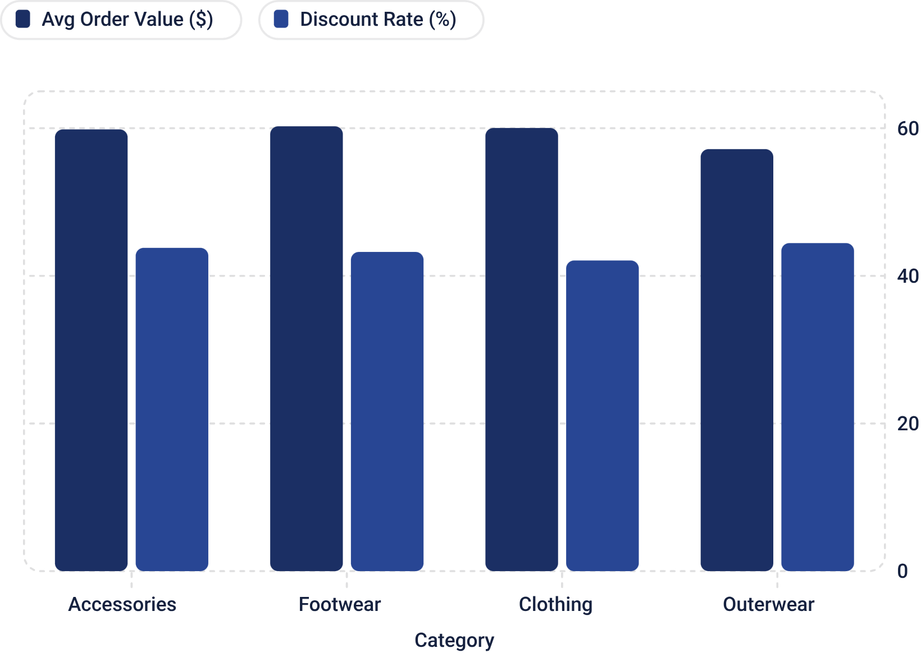
Category Performance & Shipping Preferences
Top Products per Category
Accessories: Jewelry (171), Sunglasses (161), Belt (161)
Clothing: Blouse (171), Pants (171), Shirt (169)
Shipping Preferences
Free Shipping leads with 675 orders, followed closely by Standard (654), Store Pickup (650), Next Day Air (648), Express (646), and 2-Day Shipping (627) — all tightly clustered.

Slide 9
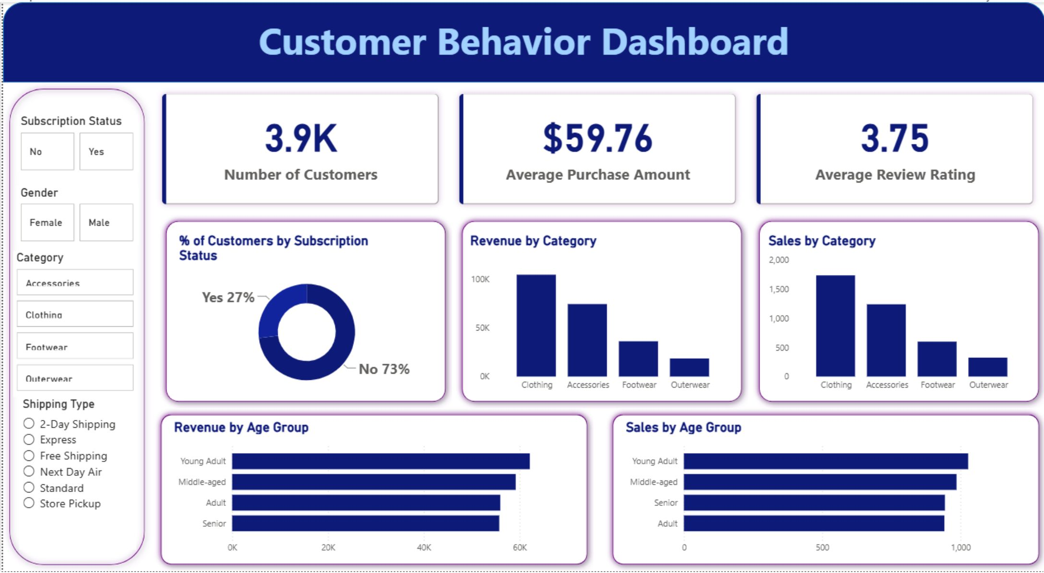
Power BI Dashboard
Dashboard Highlights
The Customer Behavior Dashboard provides a comprehensive, filterable view of all key metrics:
3.9K customers · $59.76 avg purchase · 3.75 avg rating
Subscription split: 27% Yes / 73% No
Revenue & Sales by Category (Clothing, Accessories, Footwear, Outerwear)
Revenue & Sales by Age Group (Young Adult, Middle-aged, Adult, Senior)
Filters: Subscription, Gender, Category, Shipping Type

Slide 10






Business Recommendations
Boost Subscriptions
Loyalty Programs
Promote exclusive subscriber benefits to convert high-frequency non-subscribers.
Reward repeat buyers to grow the Loyal segment (currently 3,116 customers).
Review Discount Policy
Targeted Marketing
Balance sales lift with margin control — Hats and Sneakers are 50% discounted.
Focus on high-revenue age groups and express-shipping users for maximum ROI.
Personalized Recommendations
Enhance Shipping
Recommend products based on customers' previous purchases and browsing behavior.
Expand express shipping options and ensure faster delivery to improve satisfaction.

